Slide 1
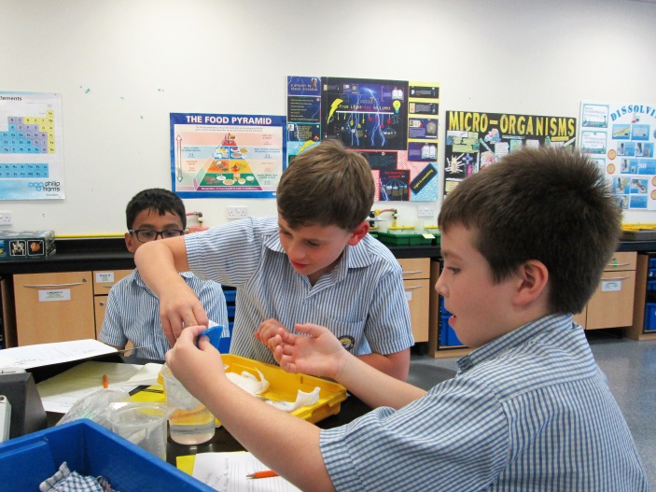
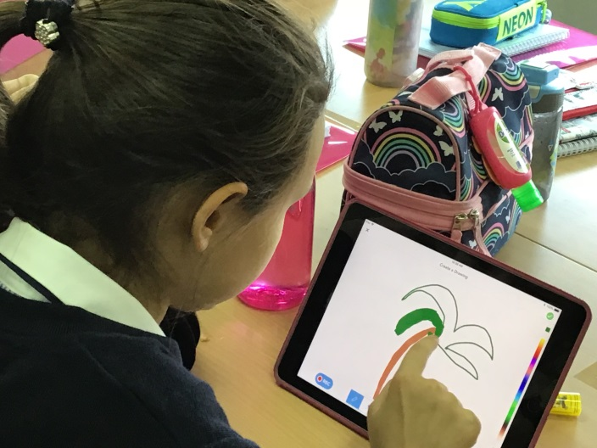
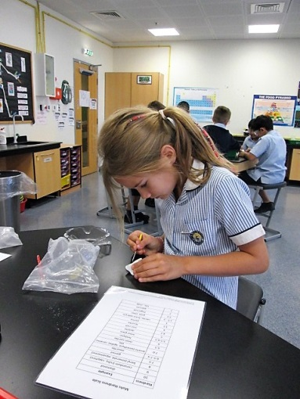
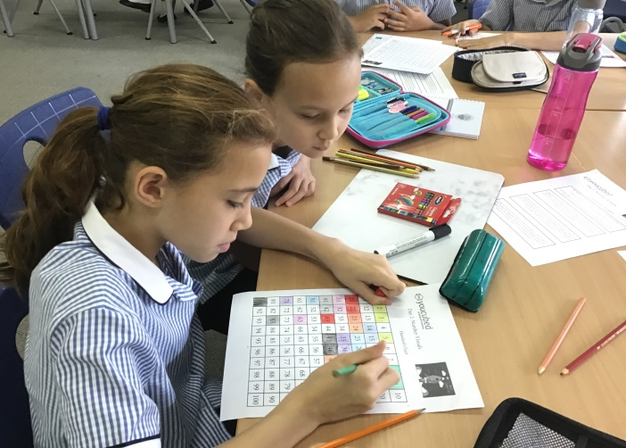
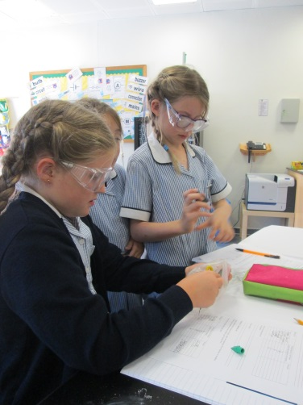
Welcome to Year 5
Vision: Building on our unique local heritage, we will provide a world class British education inspiring all our students to exceed expectations.

Slide 2
Welcome to Year 5
Vision: Building on our unique local heritage, we will provide a world class British education inspiring all our students to exceed expectations.

Slide 3
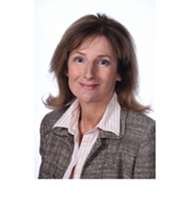
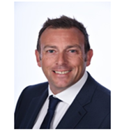
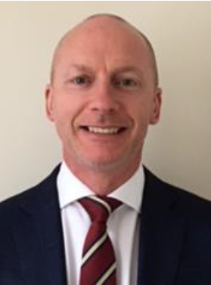
Elaine Rawlings
Head of Primary
Pete Collings
Deputy Head
Alan McCarthy
Deputy Head
Mission: Providing the best teachers, leadership and support in a not-for-profit environment, we nurture a genuine passion for learning.

Slide 4
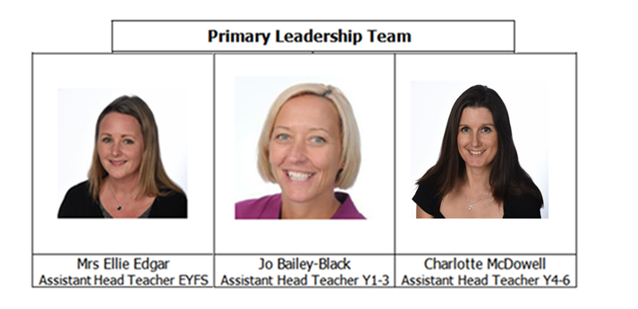
Mission: Providing the best teachers, leadership and support in a not-for-profit environment, we nurture a genuine passion for learning.

Slide 5
Year 5 Staff
Gillian Campbell – Ochre gcampbell@britishschool.sch.ae
Dave Rutland – Saffron drutland@britishschool.sch.ae
Lily Moseley – Amber lmoseley@britishschool.sch.ae
Andrea Ferrari - Henna aferrari@britishschool.sch.ae
Fizah Mehmood – Topaz fmehmood@britishschool.sch.ae
Michelle Maher– Learning Assistant
Jane Gallery – Learning Assistant
Rachel Parsons – Learning Assistant
Mission: Providing the best teachers, leadership and support in a not-for-profit environment, we nurture a genuine passion for learning.

Slide 6
Specialist teachers
Mrs Briony Emery - Learning Support teacher
Specialist teachers for PE and Swimming, Music, French, Arabic and Islamic Studies
Mission: Providing the best teachers, leadership and support in a not-for-profit environment, we nurture a genuine passion for learning.

Slide 7
GROWTH MINDSET
Mission: Providing the best teachers, leadership and support in a not-for-profit environment, we nurture a genuine passion for learning.

Slide 8
Routines
Morning registration from 7.25-7.35.
Pick up from the line on the pitch please.
Clubs
Clubs start week Commencing 23rd September
Mission: Providing the best teachers, leadership and support in a not-for-profit environment, we nurture a genuine passion for learning.

Slide 9
Organisation
Equipment requirements for the day:
Lunchbox, water bottle, Planner, reading folder for AR book, pencil case. Please no wheelie bags.
Sometimes:PE or swim kit, musical instrument.
Name everything please!
Mission: Providing the best teachers, leadership and support in a not-for-profit environment, we nurture a genuine passion for learning.

Slide 10
The Planner –
needs to be in school every day
Home/School communication
Recording homework
Effort points and other awards and achievements
Teacher’s names
Timetable
Code of conduct and rules for responsible internet use to be signed
Mission: Providing the best teachers, leadership and support in a not-for-profit environment, we nurture a genuine passion for learning.

Slide 11
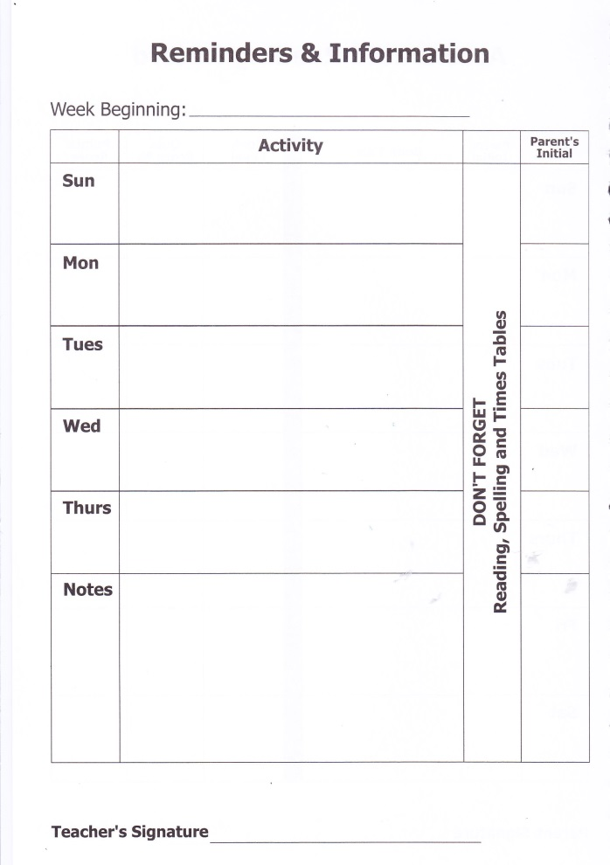
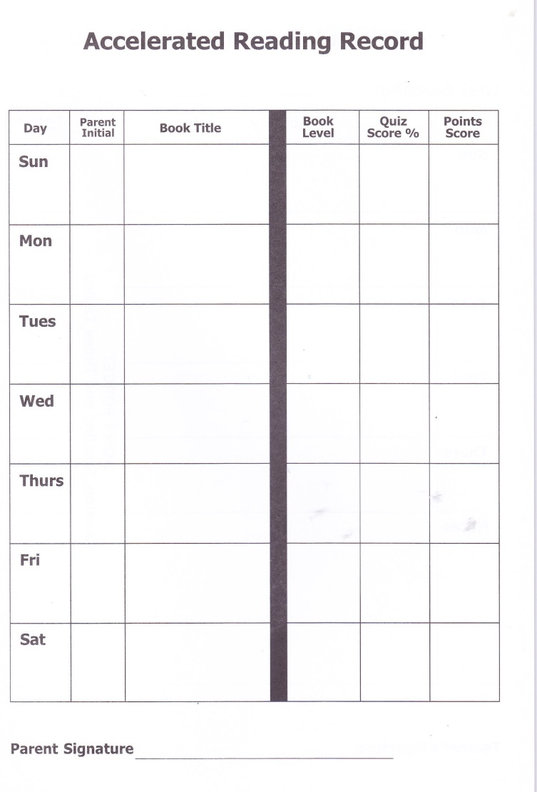
Planner
Mission: Providing the best teachers, leadership and support in a not-for-profit environment, we nurture a genuine passion for learning.

Slide 12
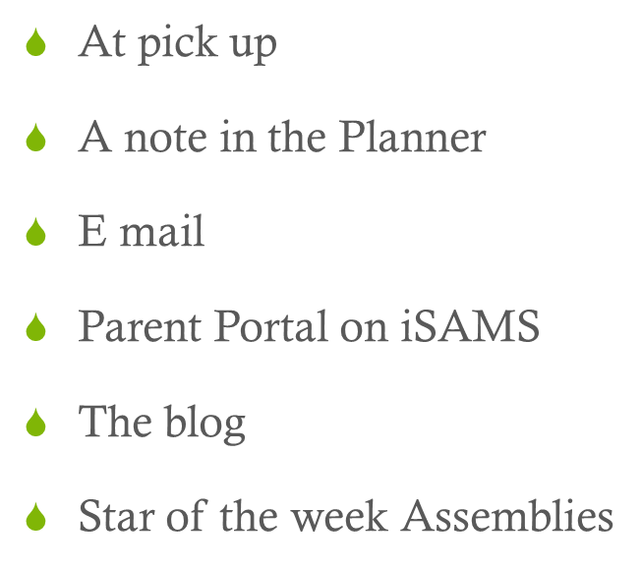
Communication
Mission: Providing the best teachers, leadership and support in a not-for-profit environment, we nurture a genuine passion for learning.

Slide 13
The Year 5 Blog
(Weebly)
Curriculum overviews
Homework
Events that are coming up
Links to learning
Twitter feeds
Please check it regularly
Year 5 – http://bsaky5.weebly.com/
- Orange trim
Mission: Providing the best teachers, leadership and support in a not-for-profit environment, we nurture a genuine passion for learning.

Slide 14
Additional learning
Reading for approx. 20 minutes per day signed at least 4 times a week
Maths additional learning every Tuesday to be handed in on Sunday and continue with practising times tables
Spelling additional learning every Sunday to be handed in the following Sunday
Other additional learning tasks are optional and a copy has been given to the children and has been posted on the weebly blog.
Mission: Providing the best teachers, leadership and support in a not-for-profit environment, we nurture a genuine passion for learning.

Slide 15
Accelerated Reader AR Reading Scheme – books need to be in school every day.
Reading books/Library books
Quizzes and tests
Expectations
Class Competitions
Library use, parents can use the library to supplement children’s reading.
Mission: Providing the best teachers, leadership and support in a not-for-profit environment, we nurture a genuine passion for learning.

Slide 16
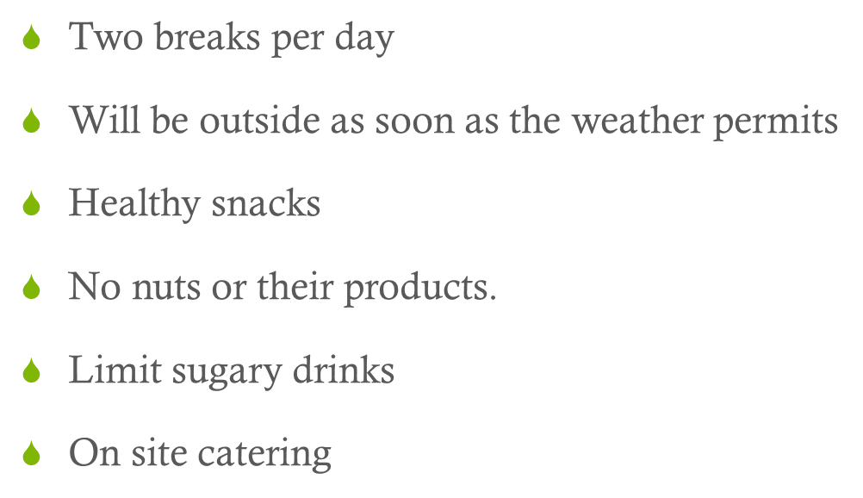
Breaks
Mission: Providing the best teachers, leadership and support in a not-for-profit environment, we nurture a genuine passion for learning.

Slide 17
Special Days
Monday 1st and Wednesday 3rd October
Primary Parents Evenings - details to follow
18th October
2nd May
Space Dome, Julia Johnson Author visit
Hoping to run an Eco adventure outdoor activities trip in December for 2 days 10th and 11th December
Mission: Providing the best teachers, leadership and support in a not-for-profit environment, we nurture a genuine passion for learning.

Slide 18
Help!
Admin and display
Support in practical lessons
Sharing expertise
Reading with children
Class Parent
Please contact your child’s teacher if you are able to help us.
Mission: Providing the best teachers, leadership and support in a not-for-profit environment, we nurture a genuine passion for learning.

Slide 19
Thank you
The team are very much looking forward to working in partnership with you.
Here’s to a great year!
Any questions for us? – We will all be here for a little while so please do not hesitate to ask any of us.
Mission: Providing the best teachers, leadership and support in a not-for-profit environment, we nurture a genuine passion for learning.

Slide 20
Mission: Providing the best teachers, leadership and support in a not-for-profit environment, we nurture a genuine passion for learning.

